Slide 1
The Stickers Printer

Slide 2

The differents products

Slide 3
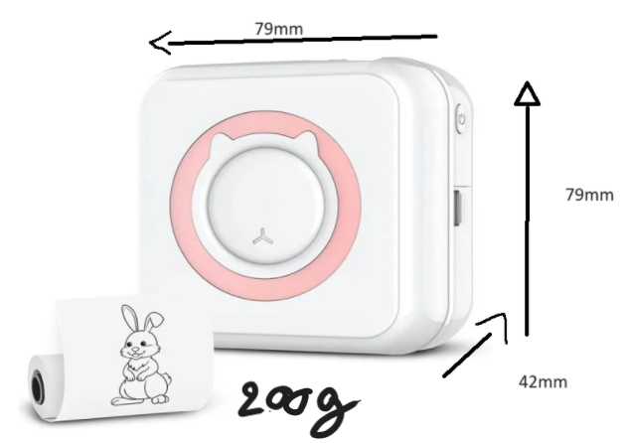
Size and dimensions

Slide 4
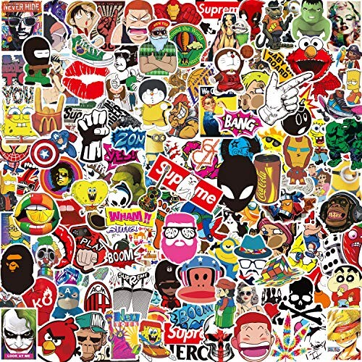
Features and Benefit

Slide 5
The elements necessary for construction and use.

Slide 6
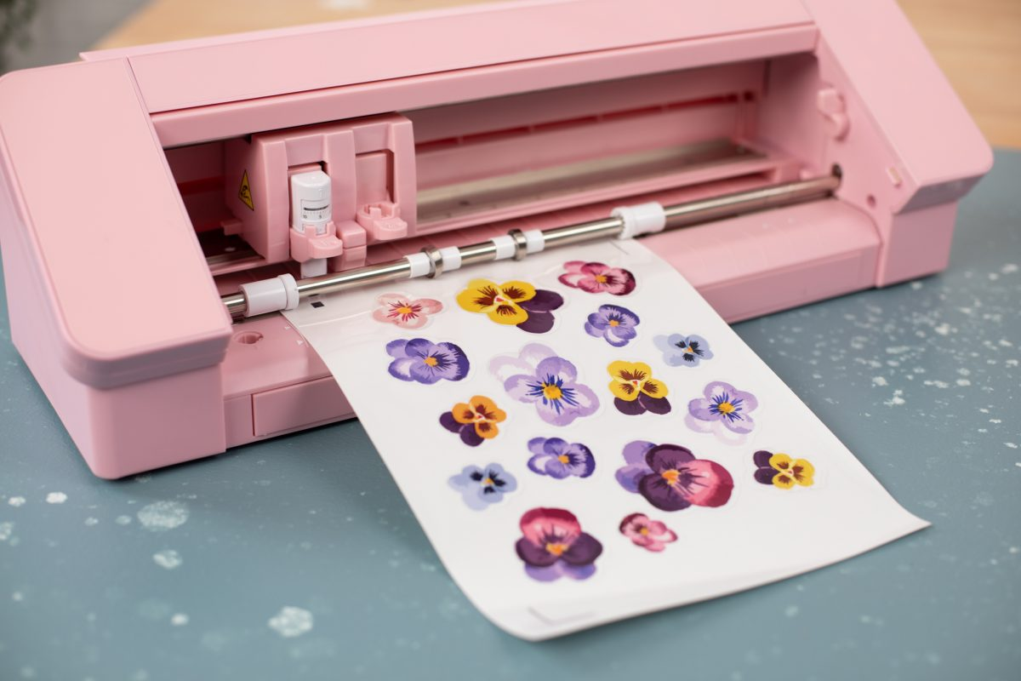
How it works

Slide 7
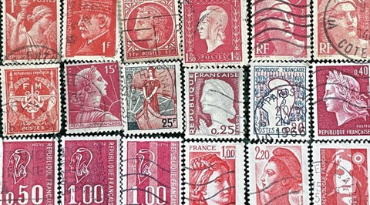
The Inspiration

Slide 8
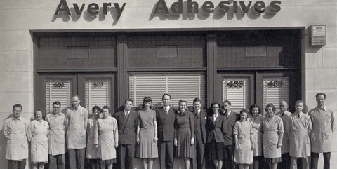
The Inventor
Ray Stanton Avery

Slide 9

Benefits to Humanity

Slide 10
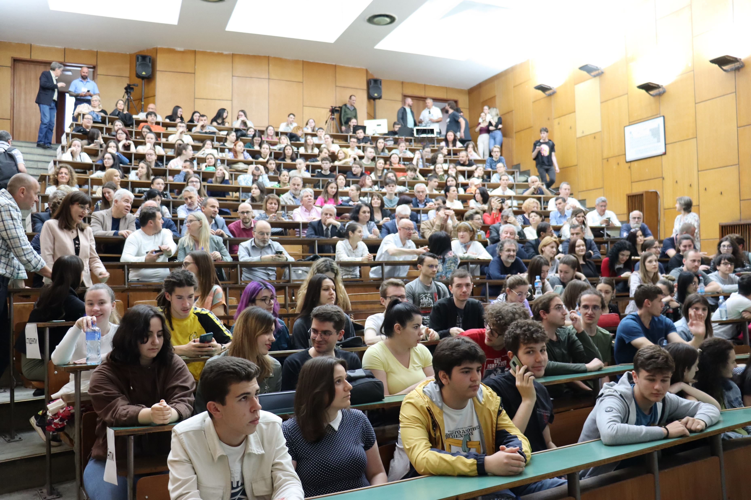

Targeted Consumers

Slide 11

Marketing Strategy

Slide 12
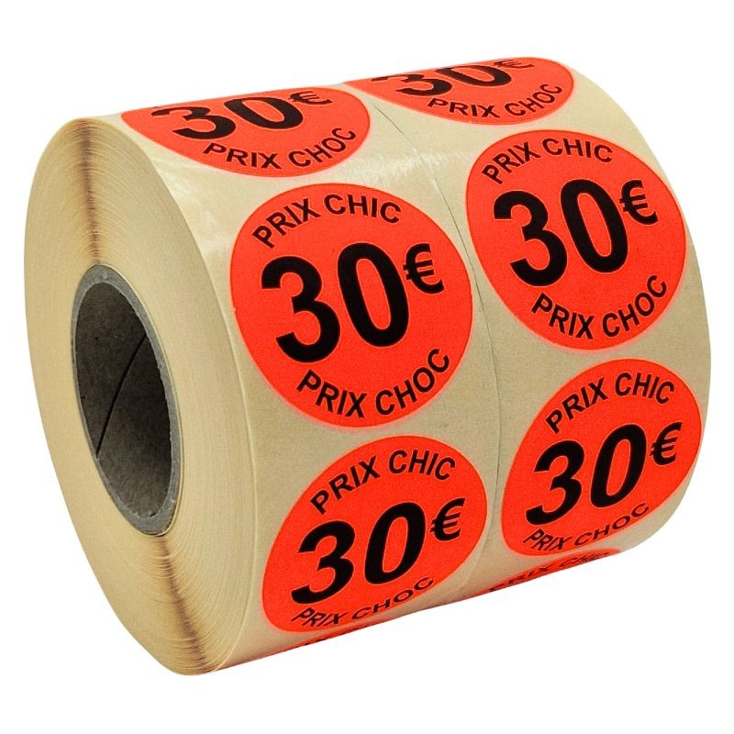
Selling price

Slide 13
https://youtube.com/clip/UgkxOI2jcypMLFZhqPZ_QYmBDtHFQrBZhVSt?si=0dHfiF4TXzdcKKEn

Slide 14
Conclusion

